Slide 1

Author Attribution Using Stylometry
Presented by: Destiny Hillis
Course Information: CSPB 4830 – Natural Language Processing
Instructor/Semester: Dr. Curry Guinn / Spring 2025
Notes:
Hello, my name is Destiny Hillis, and today I’ll be presenting my project on "Author Attribution Using Stylometry."

Slide 2

Problem Overview
Focus on authorship attribution using stylistic analysis.
Aim to classify texts based on writing style.
Important for forensic linguistics and plagiarism detection.
Challenge lies in subtle style differences detection.
Notes:
The core task I’m tackling is authorship attribution—the process of identifying who wrote a given text based on its stylistic features, rather than its content.
This has real-world applications in areas like forensic linguistics, where we might want to verify the author of a threatening letter, or in plagiarism detection, where stylistic fingerprints can reveal when someone’s submitted or published work that isn’t their own.
The challenge lies in how subtle and nuanced writing styles can be—especially between similar authors or genres. These distinctions are not always easy for humans to detect, but stylometric and machine learning techniques can help.
Photo by Thomas Kelley on Unsplash

Slide 3
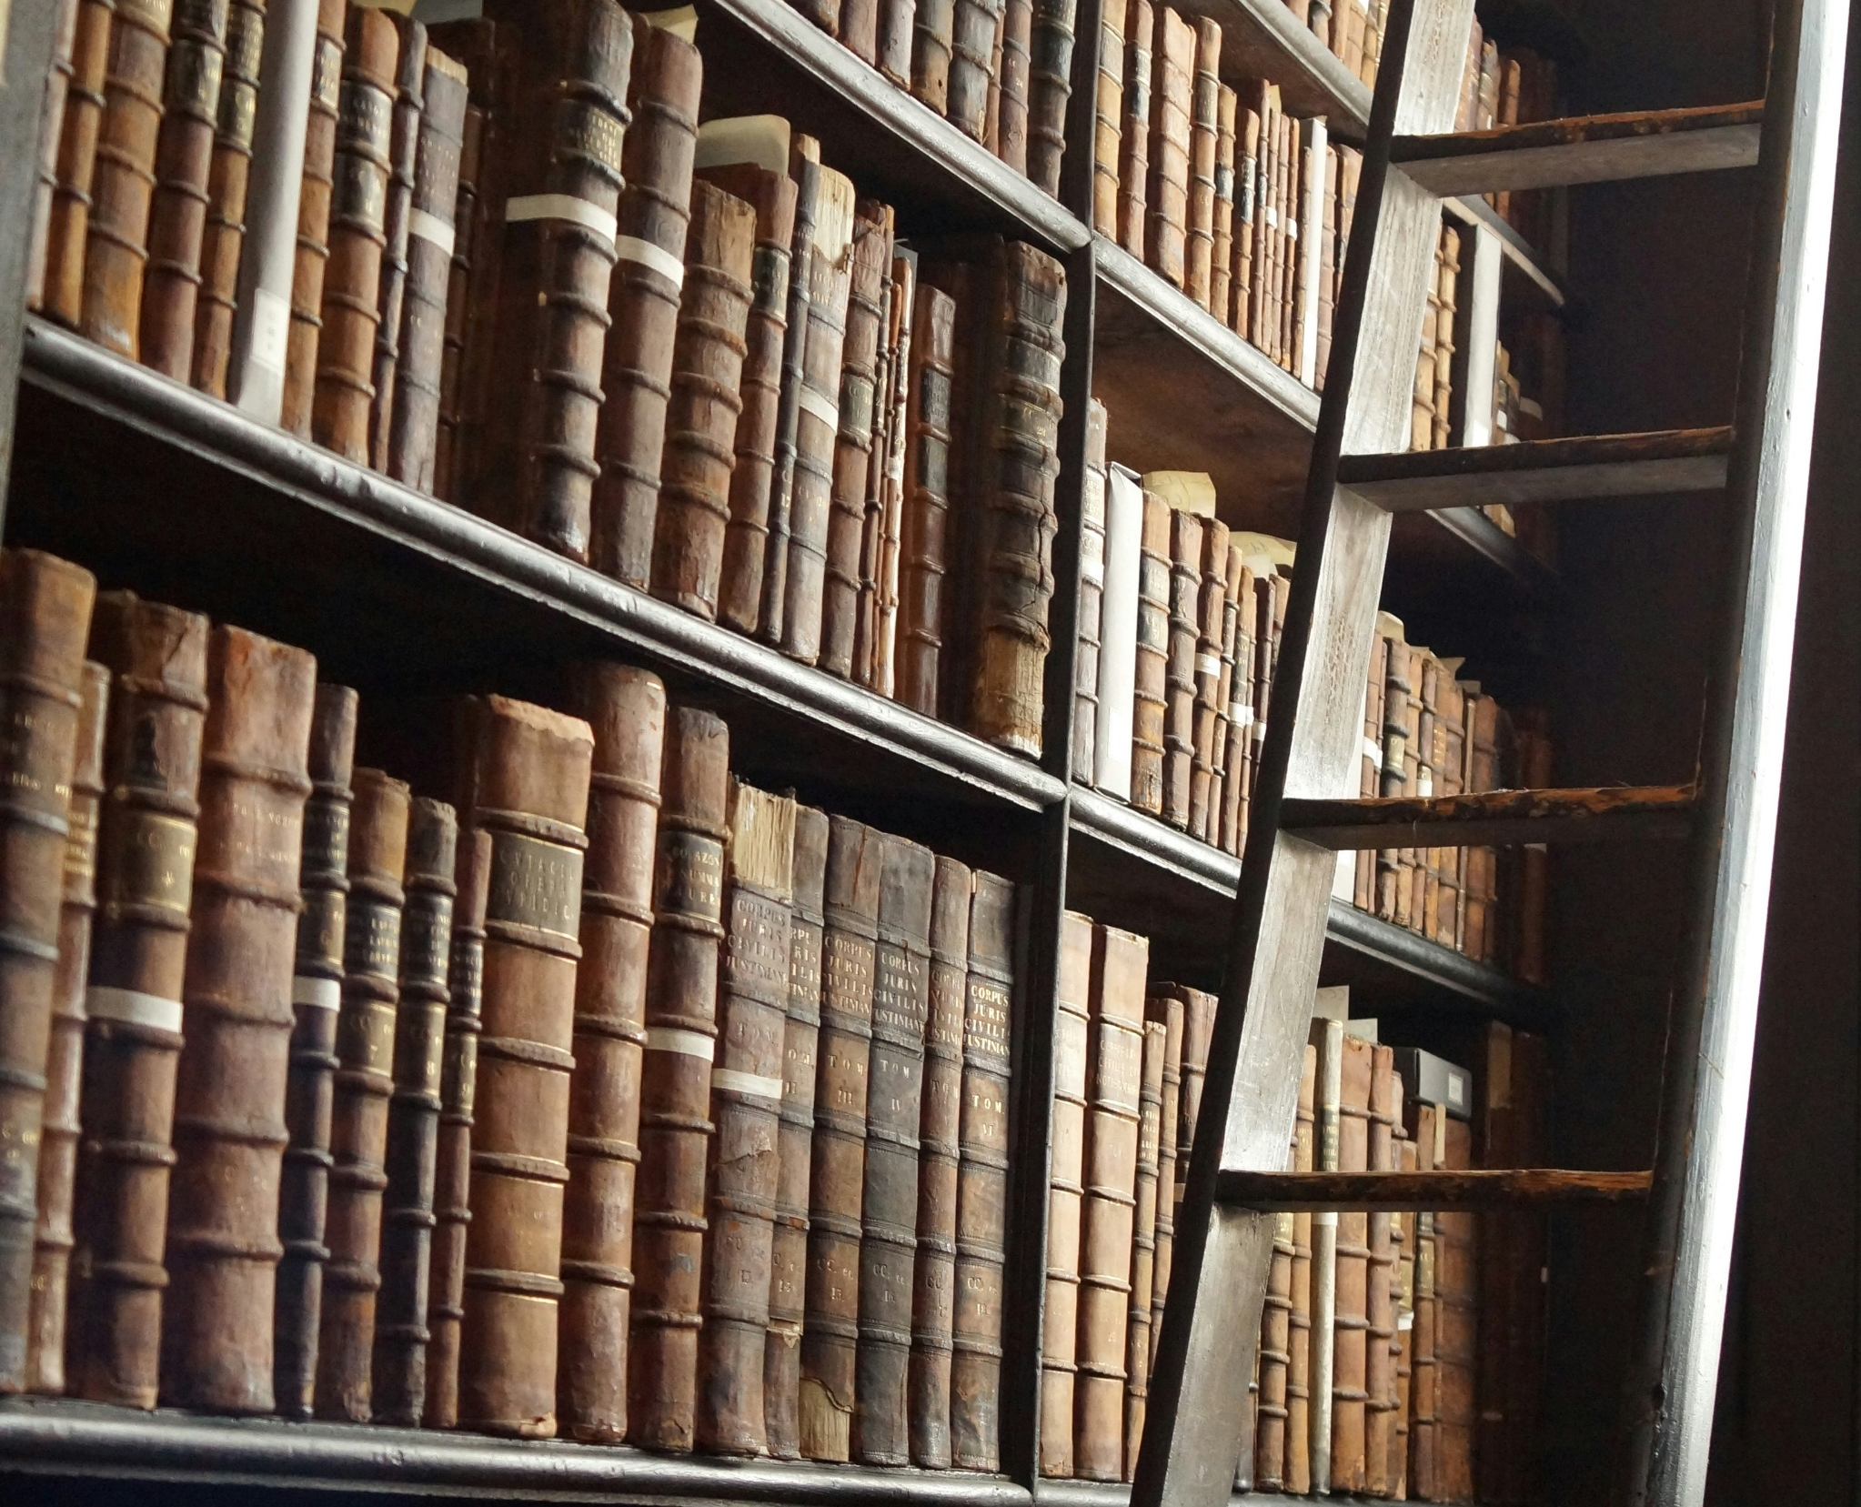
Motivation & Goals
Main goal: Compare feature-based and deep learning methods.
Key question: Can BERT outperform classic methods?
Exploring real-world authorship debates as a bonus goal.
Notes:
The main goal of my project is to compare traditional, feature-based methods of authorship attribution with a more modern, transformer-based approach using deep learning.
The key question I’m exploring is: Can a model like BERT outperform classic stylometric classifiers like Support Vector Machines (SVM) or Random Forest?
As a bonus, I’m also hoping to apply my models to an open literary question—whether F. Scott Fitzgerald may have published any of Zelda Fitzgerald’s writing as his own.
Photo by Tim van Cleef on Unsplash

Slide 4

Dataset Description
Datasets: Project Gutenberg and PAN Author Identification.
Optional datasets: Works from Zelda and F. Scott Fitzgerald.
Key preprocessing tasks include removal of metadata, POS tagging, tokenization and feature extraction.
Notes:
The two primary datasets I’m using are:
The Project Gutenberg Corpus, accessed via NLTK, which includes public domain literary texts from a range of authors.
The PAN Author Identification dataset, which is a well-established benchmark in authorship attribution research, if I can get it working. I will discuss later in the “Challenges & Lessons Learned” slide.
To address my optional stretch goal, I also need to collect works attributed to both Zelda and F. Scott Fitzgerald for exploratory testing.
Key preprocessing tasks include the removal of metadata like forwards, headers, and footnotes, part-of-speech tagging, tokenization, and feature extraction.

Slide 5
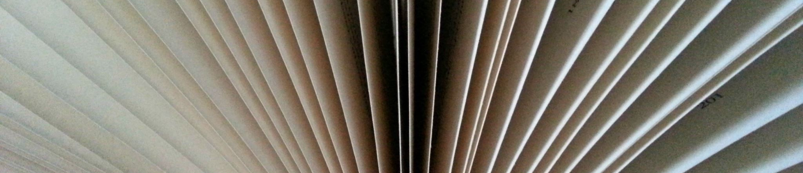
Approach Overview
Two methodologies: Feature-based and transformer-based.
Feature-based stylometry involves classifiers like Support Vector Machines (SVM) and Random Forest.
Transformer-based classification uses fine-tuned BERT.
Notes:
Like mentioned previously, my project is structured around two methodologies:
A feature-based pipeline, which involves extracting stylometric features—such as average word length, punctuation frequency, and part of speech tag distributions, to name a few—and feeding them into traditional classifiers like SVM and Random Forest. In my code, I’m trying both and then selecting whichever produces the best score.
The second methodology is a transformer-based pipeline, where I fine-tune a BERT model using the Hugging Face Transformers library to classify authors based on contextual embeddings instead of features.
A future goal I also hope to experiment with at some point is a hybrid approach that combines BERT embeddings with stylometric features to see if that improves performance.

Slide 6
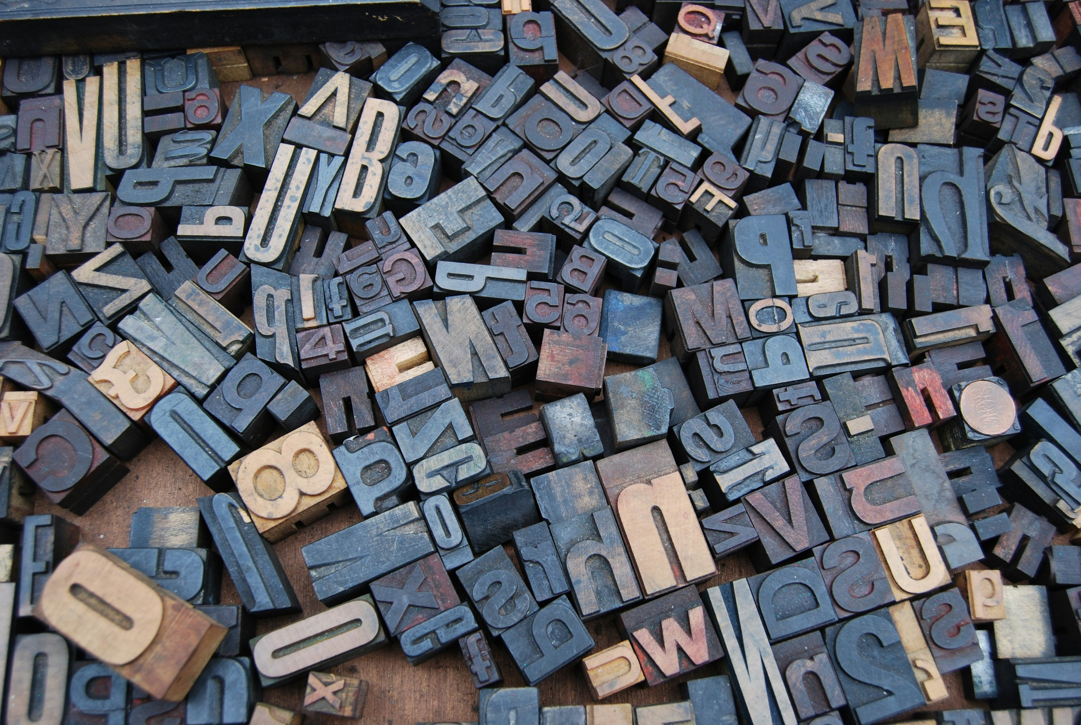
Tools & Techniques
Employing NLTK for text preprocessing.
Utilizing Scikit-learn for ML models.
BERT model fine-tuning via Hugging Face Transformers.
Matplotlib for visualization.
Notes:
For tools and libraries:
I’m using NLTK for text preprocessing and POS tagging.
Scikit-learn provides the machine learning models SVM and Random Forest.
Hugging Face Transformers is used for BERT fine-tuning.
I’ve incorporated tools like Matplotlib because I plan to better visualize, evaluate, and compare the results.
Photo by Amador Loureiro on Unsplash

Slide 7

Experiments & Analysis
Built two pipelines: feature-based (SVM/Random Forest) and transformer-based (BERT)
Dataset preprocessing and model training
Extracted lexical, syntactic, and structural features from literary datasets
Evaluating both models using precision, recall, F1-score, and confusion matrices
Visualizations to aid in analysis
Notes:
Here’s a quick summary of the experiments and analysis I’ve completed or have in progress:
Preprocessing of the Gutenberg dataset is complete. As a reminder, preprocessing included stripping out metadata, POS tagging, tokenization for the transformers method, and feature extraction for the classifier method.
I’m extracting character, word, and syntax features for the feature-based approach. For example, punctuation frequency, n-grams, vocab richness, sentence length, and POS frequency, among others.
I’ve outlined and started to build both the feature-based and BERT-based pipelines. I’m still working on the training section of those pipelines.
Both models will be evaluated using precision, recall, F1-score, accuracy, and confusion matrices.
I also plan to generate visualizations to better understand how each model is making decisions.
Photo by Anne Nygård on Unsplash

Slide 8
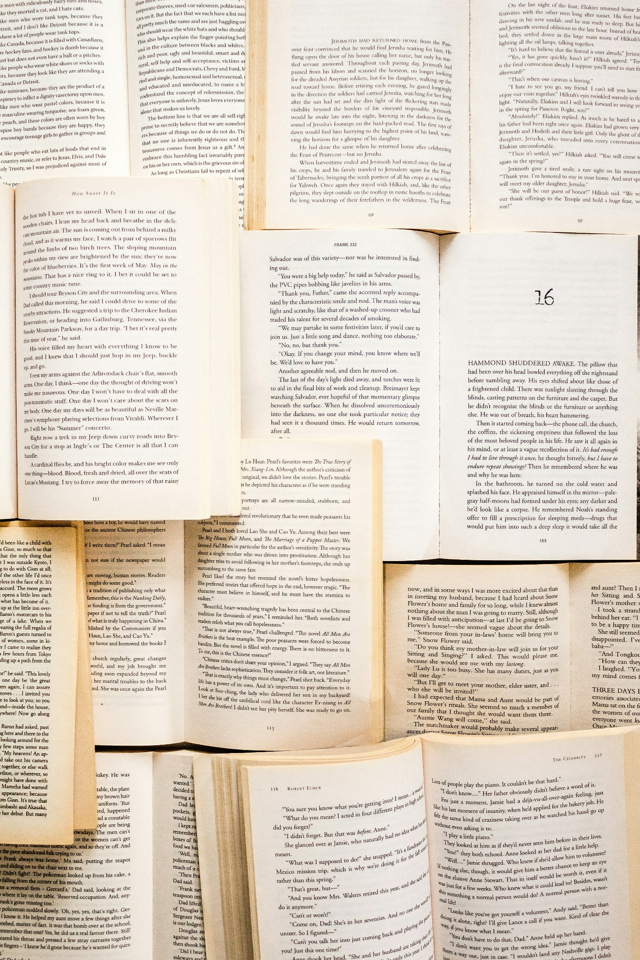
Results
Outputs include precision, recall, F1-score, and accuracy.
Visualizations like confusion matrices.
Notes:
Since I’m still in the model training phase, I don’t have final numbers to present just yet.
However, I expect to report results using the metrics I mentioned: precision, recall, F1-score, and accuracy. I’ll also include confusion matrices to show which authors are most often misclassified, and potentially add visualizations to see how author styles cluster.
Photo by Sincerely Media on Unsplash

Slide 9
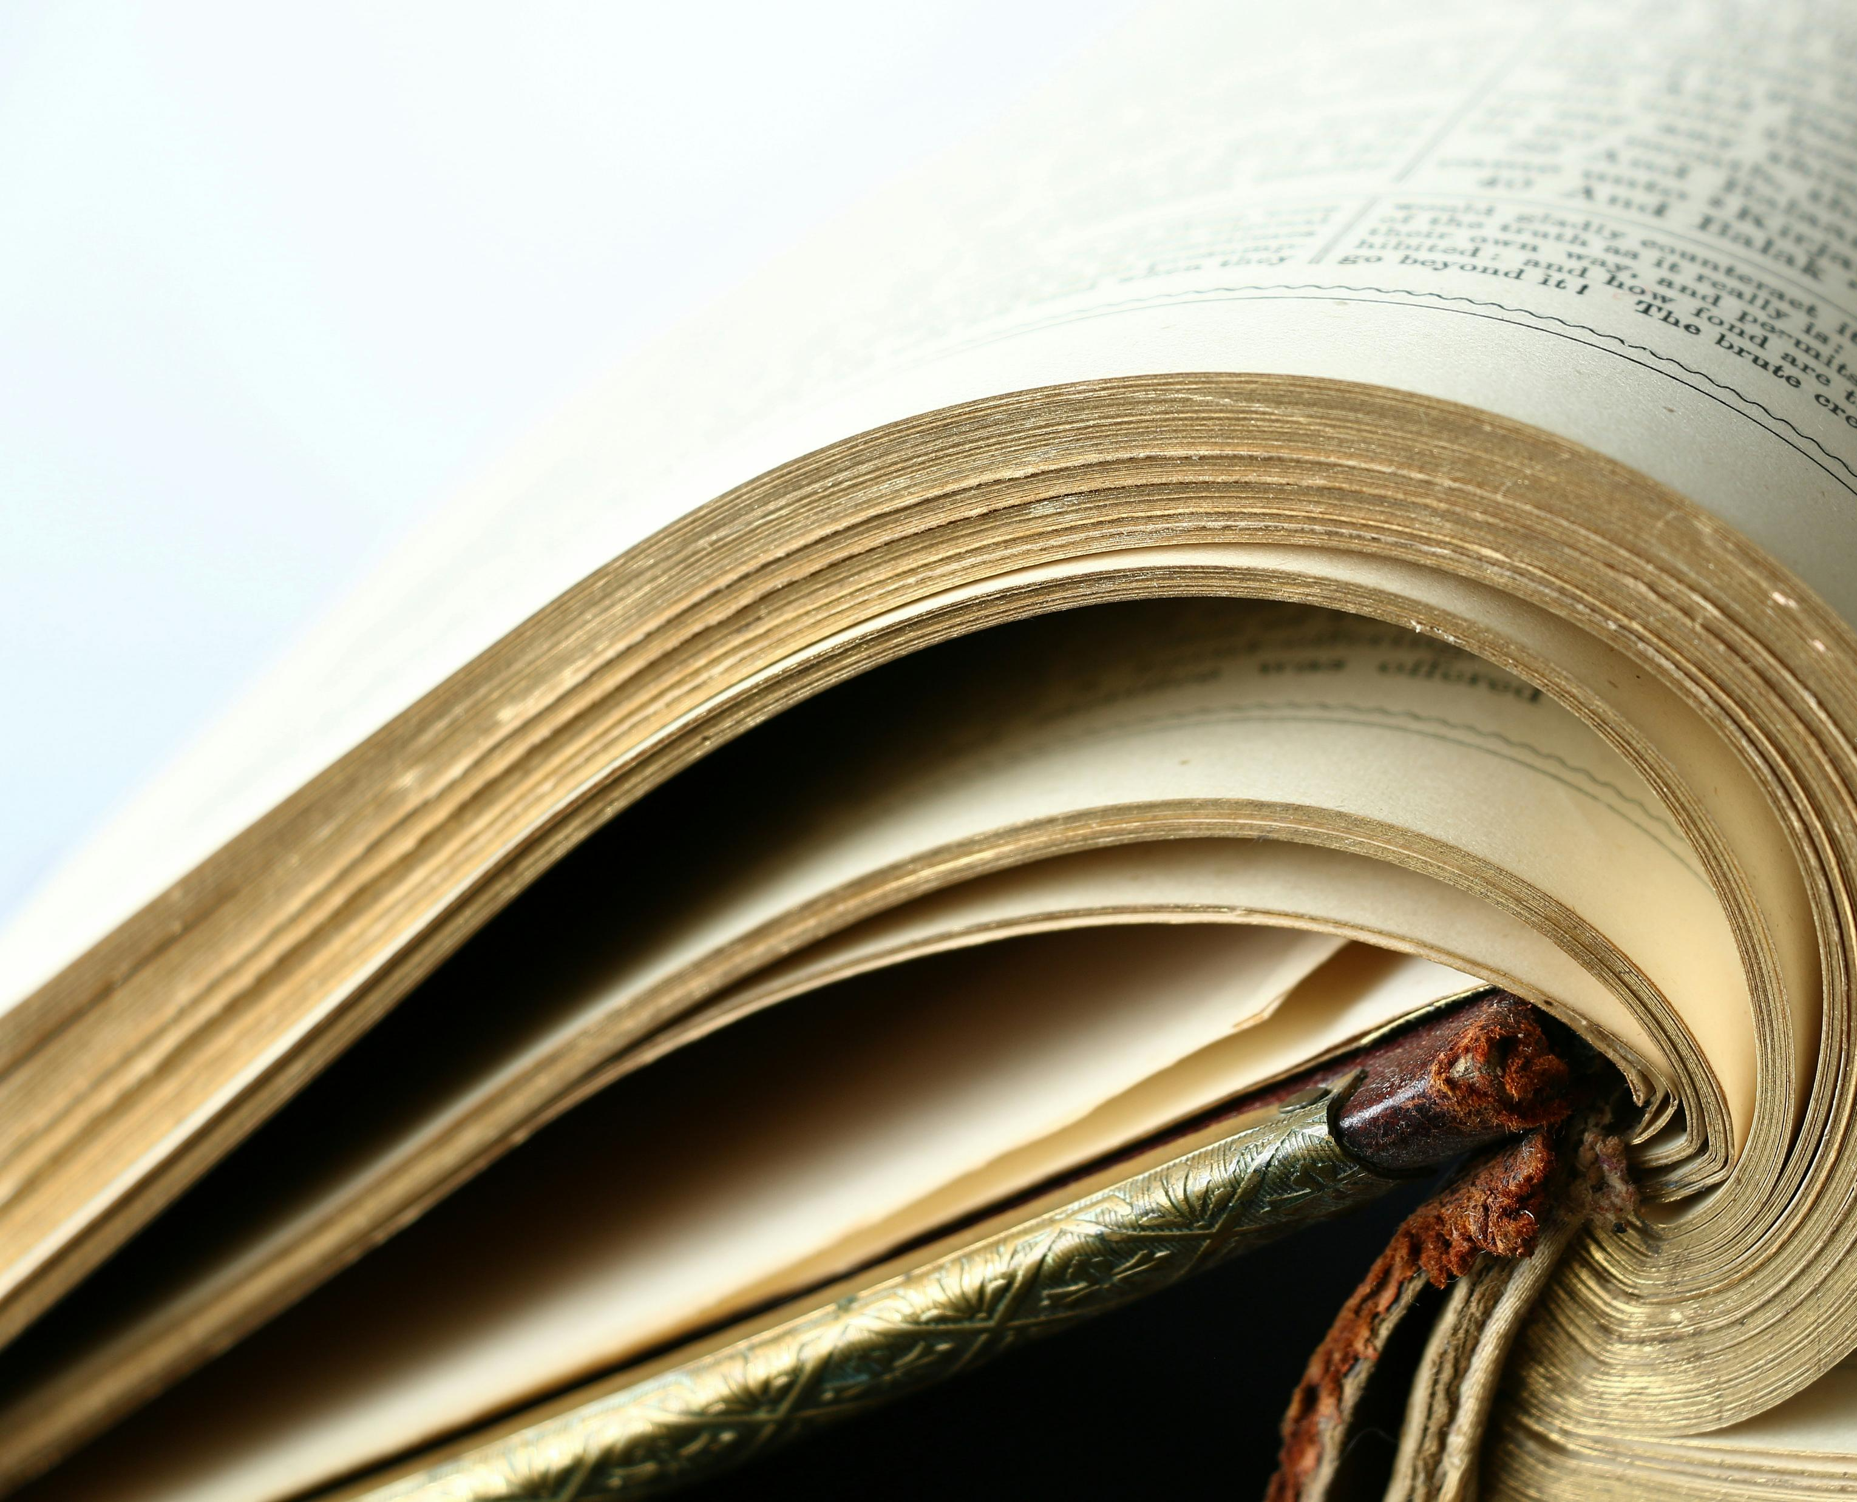
Challenges & Lessons Learned
PAN dataset is not easy to acquire or parse/use
Variability in stylometric features based on text length.
Normalization of features is crucial for comparisons.
Addressing topic leakage in transformer models.
How to compare totally different methods?
Notes:
Along the way, I’ve encountered several challenges:
First, the newer PAN datasets require approval and I wasn’t able to receive it in time. I found older versions available, but they are not the easiest to parse and use. I’m still working through this and hope to be able to include it in my final submission of the project.
Also, stylometric features can vary significantly based on the length of the text, which complicates comparisons. I’ve had to be careful about normalizing features to avoid skewed results. (e.g., to control for differences in text length or frequency ranges before feeding them into classifiers.)
In the deep learning pipeline, BERT might classify texts based on subject matter rather than true stylistic patterns. I believe this is called topic leakage.
Finally, deciding how to fairly compare such fundamentally different model architectures has been an important learning experience.
Photo by Pierre Bamin on Unsplash

Slide 10

Conclusion & Future Work
Apply models to disputed authorship cases (e.g., Zelda vs. F. Scott Fitzgerald)
Experiment with feature fusion: combine stylometric features with BERT embeddings
Notes:
In summary, my project aims to evaluate whether deep learning models like BERT can outperform traditional stylometric techniques in author attribution—and whether the two approaches might even be stronger together, something I would like to explore in future work.
Looking ahead, I plan to:
Apply the models to literary attribution debates, such as the Zelda/F. Scott Fitzgerald case. This is the controversial idea that F. Scott Fitzgerald may have published some of his wife, Zelda’s, works as his own. This has been an ongoing dispute for the past century and it would be fun to use NLP to help determine a potential answer.
I would also like to explore hybrid approaches that combine the precision of stylometry with the semantic depth of transformer models. Logically this seems like it would provide the best accuracy, taking advantage of the best of both worlds.
Thanks so much for listening and I appreciate any feedback you may have.
Photo by Peter Herrmann on Unsplash

